Slide 1
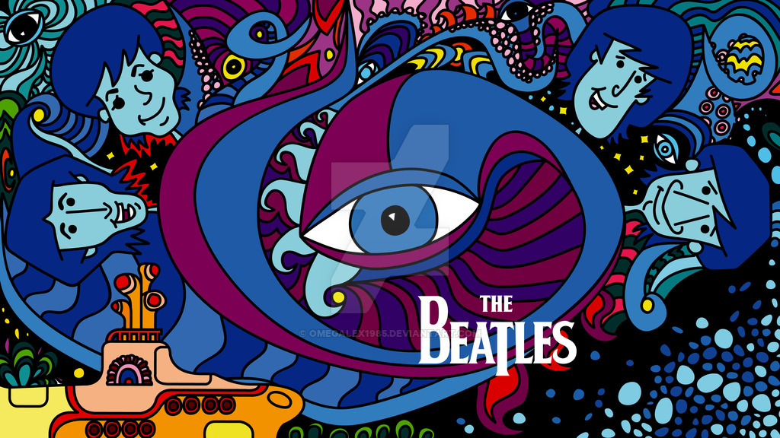
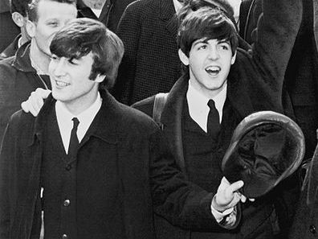
Was It John Or Was It Paul?
By Leonid Klok
The Beatles lyrics classifier

Slide 2
The Beatles Lyrics Classification
Three lyrics classifiers/predictors:
John Lennon vs Paul McCartney
Early Beatles vs Late Beatles
The Beatles vs The Rolling Stones

Slide 3
Disclaimer
Italic font style is used in the presentation to indicate that it is the actual Beatles song title.

Slide 4
Why Beatles?
I love music in general, I used to play piano, classical guitar and these days I sometime do vocal performances with the little help from my friends karaoke machine.
The Beatles are the most influential rock band of all time.
Back in Russia, when I started learning English, I used Beatles lyrics to improve my vocabulary. So in a way, The Beatles opened a door for me into the free world.

Slide 5
Major Challenges
Very small dataset for statistical modeling (ended up with 120 songs only for the first classifier).
Sometimes it was difficult to determine, whether the author of certain songs was Lennon or McCartney (“written by Lennon/McCartney”). Additional research was required.
There are no dramatic differences in the lyrics analyzed, which made the modeling/predicting more difficult. The vocabulary in general was quite repetitive (to be illustrated later).

Slide 6
Initial Dataset
The Beatles: All original albums starting from “Please please me”. Songs that were released separately (for example, “Lady Madonna”) were not included.
The Rolling Stones: Fifteen albums released in the same years as the Beatles albums included in the set 1963-1970.

Slide 7
Major project phases
Web scraping - go and get the data.
Data cleanup.
Statistical modeling.

Slide 8
Chapter 1 - Misery or Web Scraping Nightmare
Web pages scraped/were supposed to be scraped:
Lyrics.com. Started working on it and then it turned out their list of Beatles songs was incomplete! As a result the idea of scraping lyrics.com was….scrapped!
Azlyrics.com. I ran the process for the first time and didn’t follow the proper webscraping protocol. I ended up crashing the site. The whole Bitmaker space lost access to this website as a result. Then I reran the process from home following the protocol. The process crashed again. I still managed to upload the majority of the songs.

Slide 9
Chapter 1 - Misery or Web Scraping Nightmare
Web pages scraped/were supposed to be scraped:
Genius.com. -Uploaded the last two Beatles albums and also all selected Rolling Stones albums.
en.wikipedia.org/wiki/List_of_songs_recorded_by_the_Beatles - uploaded the author of Beatles songs. This has been validated against beatlesbible.com/songs, the site that contains some very detailed information about each Beatles song.

Slide 10
Chapter 1 - Misery or Web Scraping Nightmare
Tools used:
Requests
BeautifulSoup
Regex

Slide 11
Chapter 2 - A Day In The Life (of a Data Scientist) - Data Cleanup
Up to 18 files/dataframes had to be merged into one classifier model.
The data loaded from web pages had a lot of junk. Here is an example:
'[<div id="fb-root"></div>, <div>\r\n<!-- Usage of azlyrics.com content by any third-party lyrics provider is prohibited by our licensing agreement. Sorry about that. -->\r\r\nIt won\'t be long yeh, yeh, yeh<br/>\r\nIt won\'t be long yeh, yeh, yeh<br/>\r\nIt won\'t be long yeh, till I belong to you<br/>\r\n<br/>\r\nEvery night when everybody has fun<br/>\r\nH
Used Regex again for some string cleanup.

Slide 12
Chapter 3 -Across the Universe -Statistical Modeling
Stage 1: Vectorizing.
Tools used:
-CountVectorizer - used to count the number of times words were used.
-Word Cloud - see slides ##15-17.
-TfidfVectorizer - used to create a column for each word used in lyrics and count its frequency in texts.

Slide 13
Chapter 3 -Across the Universe -Statistical Modeling
Stage 2: Machine Learning/Deep Learning models and other sexy terms.
Tools used (including GridSearch):
-Logistic Regression
-Random Forest
-AdaBoost
-KNeighbors
-SVC
-Neural Networks (Keras)
--

Slide 14
Chapter 4 - Here Comes the Sun - The Major Results
The most popular words in each set
Model accuracy

Slide 15
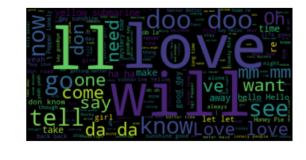
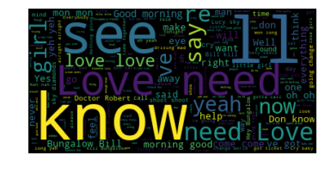
The Most Popular Words
John Lennon
Paul McCartney

Slide 16
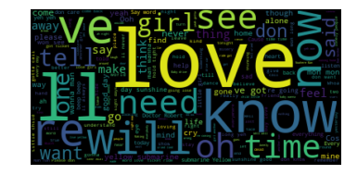
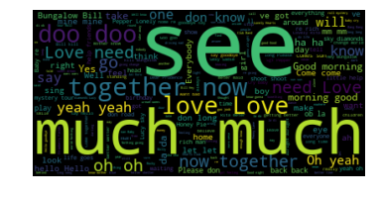
The Most Popular Words
Early Beatles
Late Beatles

Slide 17
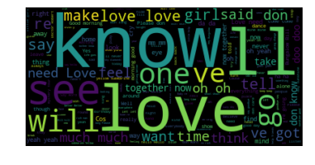
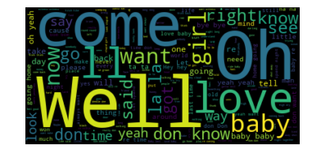
The Most Popular Words
Beatles
Rolling Stones

Slide 18
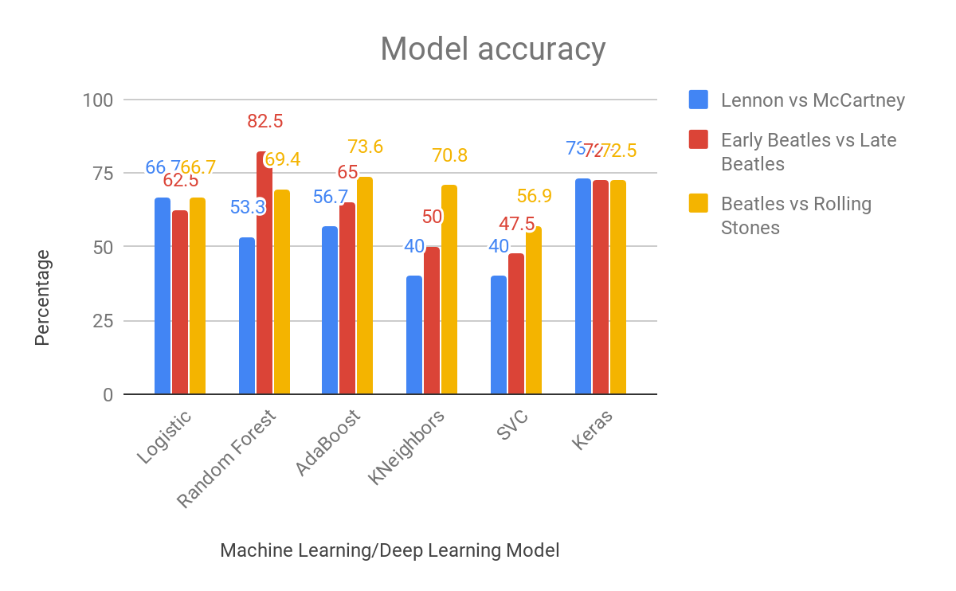

Slide 19
Chapter 5 - All I’ve Got To Do - The Next Steps
Removing the refrain from the lyrics (for example, “ Love love love”, “Hey Jude, Hey Jude” etc.) to get a better quality for text corpus.
Fitting additional machine learning models (decision tree, XGBoost etc.)
Trying different configurations of Keras Neural Network (Recurrent Neural Network, LSTM etc.)

Slide 20
Chapter 6 - Here, There and Everywhere - The Application
Marketing (analyzing user conversations, classification of users)
Emergency response system
Political campaigns

Slide 21
Chapter 7 - The End or The Long and Winding Road
This concludes the presentation but our Data Science journey is just getting started.

